Slide 1
CSD 1401
Command Line Vs Tools
Fundamentals
Motivation

Slide 2
Fundamentals

Slide 3
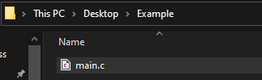
Basic Situation
We have a file called “main.c” in a folder called “Example” on the “Desktop”
#include <stdio.h>
int main(void)
{
printf("Hello World");
}
“main.c” contains code to print “Hello World” on screen

Slide 4

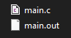
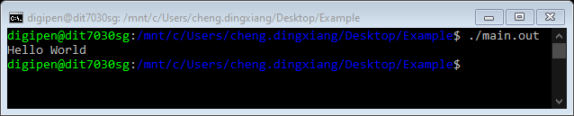
Basic Situation
Compile
An excutable is created
Execute

Slide 5
Question
How does this work?

Slide 6
Question
gcc is a program just like main.out
Upon execution, gcc has access to all the elements present in this line, and uses them as input.

Slide 7
Updated Situation
New
In “main.c”, we added “int argc, char * argv[]” within the “main” function brackets.
#include <stdio.h>
int main(int argc, char *argv[])
{
int i;
for(i = 0; i < argc; ++i)
{
printf("%s ", argv[i]);
}
printf("\n");
}
Original
#include <stdio.h>
int main(void)
{
printf("Hello World");
}
This gives us access to the other parameters given when we call the executable.

Slide 8
Updated Situation
New
Here we will be printing every input parameter we can read from the start of the execution.
Note that in the new code, there is no “Hello World” in it.
#include <stdio.h>
int main(int argc, char *argv[])
{
int i;
for(i = 0; i < argc; ++i)
{
printf("%s ", argv[i]);
}
printf("\n");
}
Original
#include <stdio.h>
int main(void)
{
printf("Hello World");
}

Slide 9
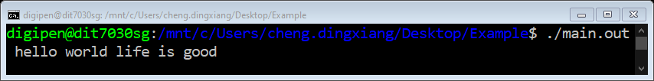
Updated Situation
Compile the new code
Now when executing “main.out”, we added “hello world life is good” after it.

Slide 10
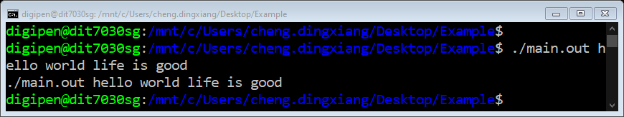
Updated Situation
Upon execution, notice every element in the previous command has been printed.
Also remember that “hello world” was not coded into “main.c”. It was read from here.

Slide 11
Motivation
Why talk about this?

Slide 12
Motivation 1
In this school, there is a focus learning from the ground up.
You will be writing software tools that would support other software.
So you need to understand the fundamental form of these tools

Slide 13
Motivation 2
You need to understand the scope and responsibilities of the scope of your tools
For many visual tools, they are just a medium to provide better accessibility to functions people need.
Do not get too hung up on the tools.
Some tools make life easier
When problems arise, seek the root cause.

Slide 14
Motivation 2 - Metaphor
Any school can help prepare you for the Cambridge GCE examinations
The real value is the knowledge which gets you the certificate and a better future.

Slide 15
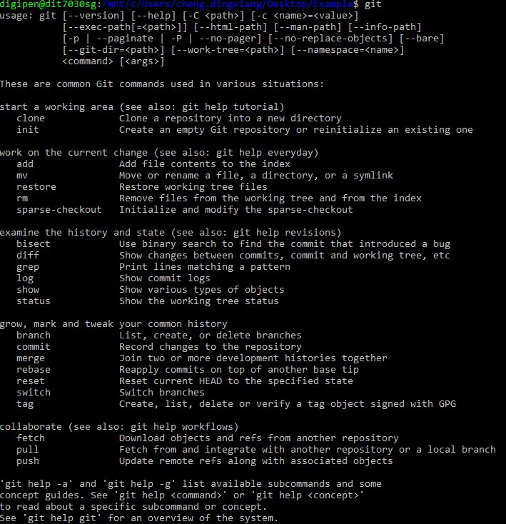
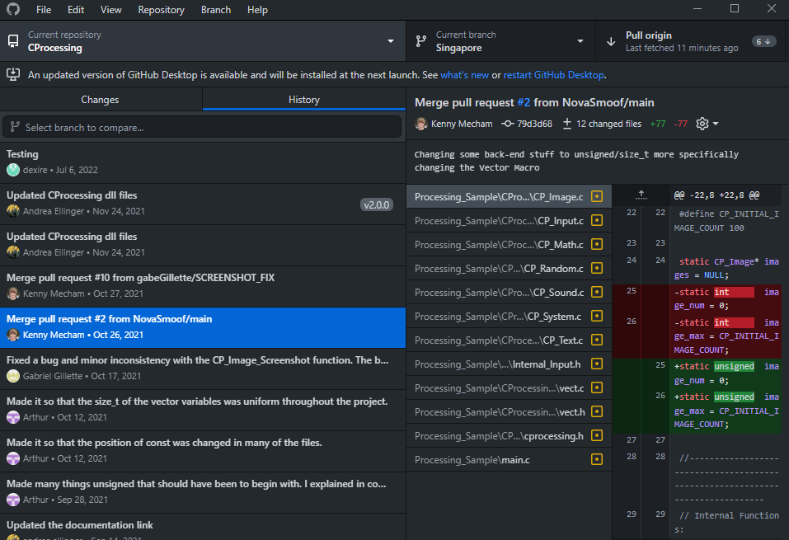
Motivation 2 - Examples
Git Command line
GitHub Desktop

Slide 16
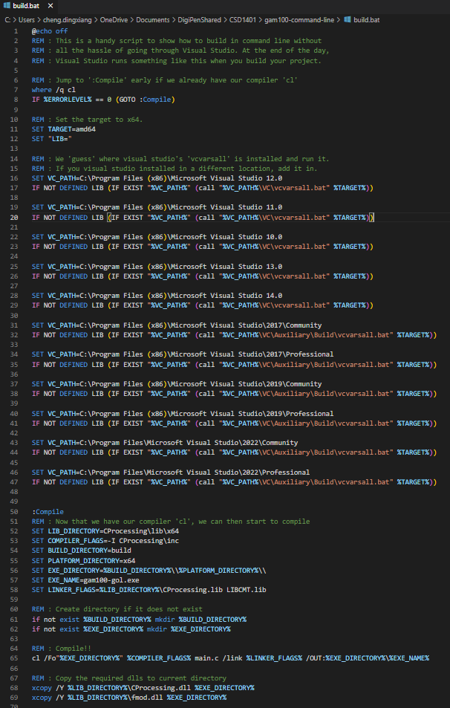
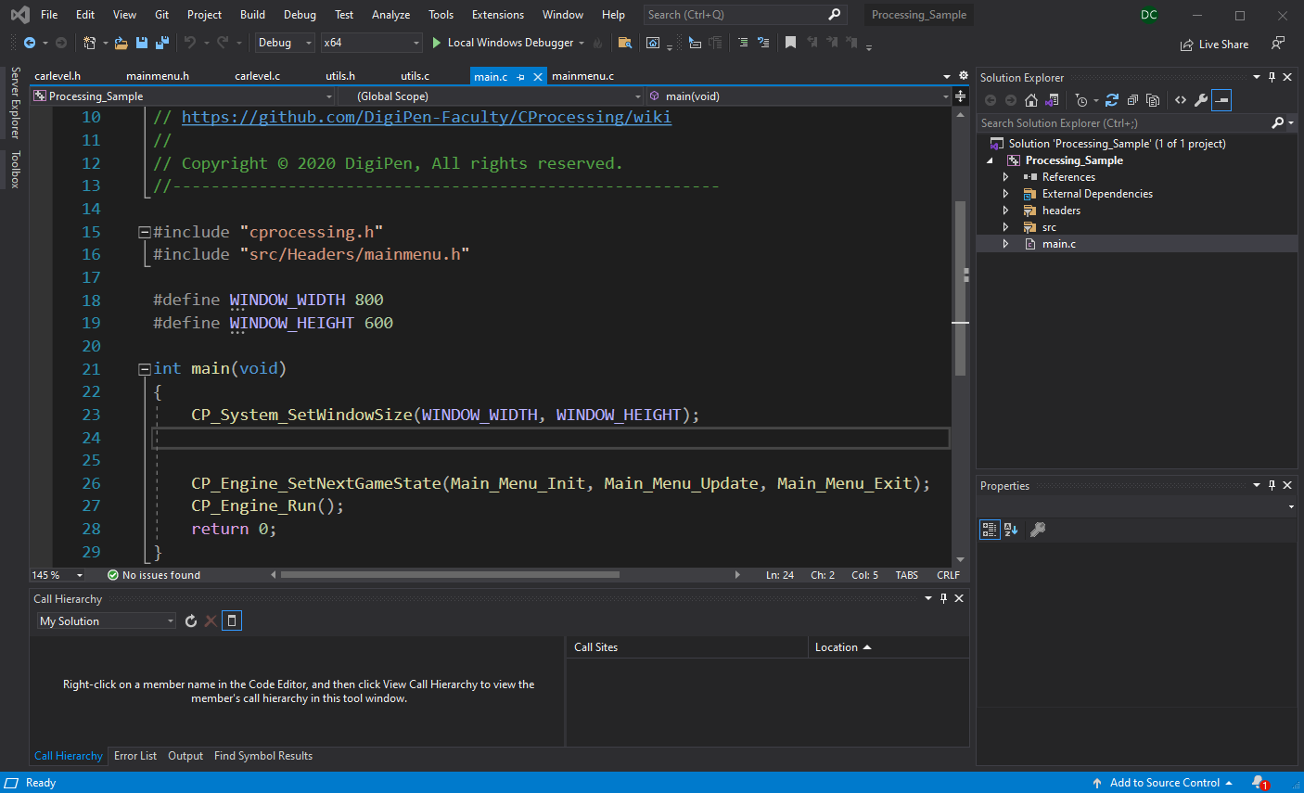
Motivation 2 - Examples
Visual Studios Command line
Visual Studios

Slide 17
Motivation 3
Business/Operational considerations
Visual tools can come with a cost
Visual tools require their own set of updates and technical support
Visual tools may be out of sync with a standard you are working on

